Slide 1



Clustering algorithms
Information retrieval systems « SRI »
Grine lyes

Slide 2

Clustering algorithms
DEFINITION
TYPES OF ALGORITHMS
K-MEANS
DEMO

Slide 3
Definition
Clustering algorithms are a machine-learning technique that discovers patterns and groups together similar data points. It is used to group sets of data points into a number of clusters, which helps extract underlying patterns in data and transforms raw data into meaningful knowledge.

Slide 4
Clustering algorithms are unsupervised learning approaches that group comparable data points into clusters based on their similarity. The identification of such clusters leads to segmentation of data points into a number of distinct groups.

Slide 5
Types of clustering algorithms
There are several types of clustering algorithms, like centroid-based, density-based, distribution-based, and hierarchical clustering.
Each type of clustering algorithm is best suited to a particular data distribution and has its own advantages and disadvantages.

Slide 6
Example of clustering algorithms
K-means algorithm
DBSCAN
Gaussian Mixture Model
Agglomerative Hierarchical Clustering
…

Slide 7
K-MEANS
K-Means Clustering is an Unsupervised Learning algorithm, which groups the unlabeled dataset into different clusters.
Were K defines the number of pre-defined clusters that need to be created in the process, So if K=5, there will be five clusters, and so on.

Slide 8
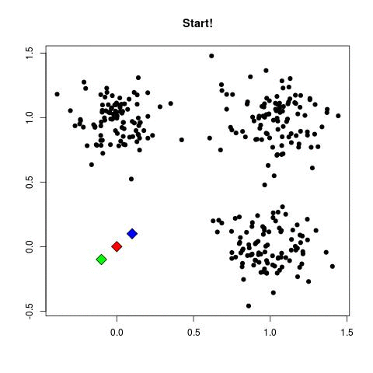
if : K=3

Slide 9
K-MEANS - Steps
Select the number of clusters K .
Select random K points or centroids.
Assign each data point to their closest centroid.
Calculate the variance and place a new centroid of each cluster.
Repeat Step 3 and Step 4 for N number of times.
Stop if you loop N times or if the values of Step 4 don’t change.

Slide 10
K=2

Slide 11

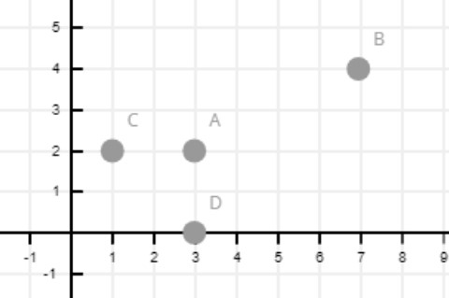
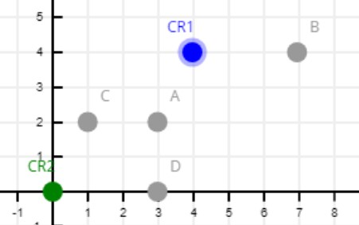
Example
 | X | Y
A | 3 | 2
B | 7 | 4
C | 1 | 2
D | 3 | 0
Given k=2
We take two random points
Cr1 = (4,4)
Cr2 = (0,0)

Slide 12
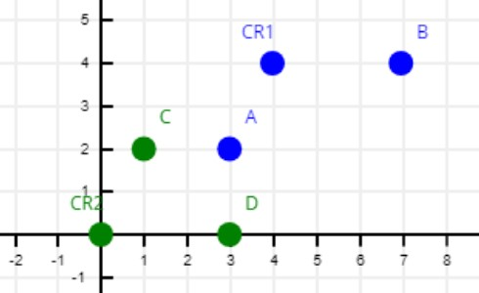
calculate the distance (Step 3) d=√((x2 – x1)² + (y2 – y1)²)
 | A | B | C | D
CR1 | √5 | √9 | √13 | √17
CR2 | √13 | √65 | √5 | √9
So :
CR1 = { A, B}
CR2 = { C, D}

Slide 13
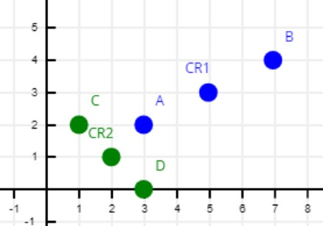


calculate the variance (Step 4) cr = ($\frac{\text{∑}xi}{n} ,\frac{\text{∑}yi}{n})$ $n$ = number of point in the CL cluster
CR1 = ($\frac{\text{3+7}}{2} ,\frac{\text{2+4}}{2})$ = (5,3)
CR2 = ($\frac{\text{1+3}}{2} ,\frac{\text{2+0}}{2})$ = (2,1)

Slide 14
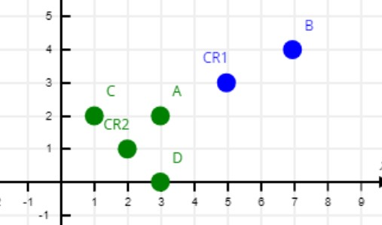
calculate the distance (Step 3) d=√((x2 – x1)² + (y2 – y1)²)
 | A | B | C | D
CR1 | √5 | √5 | √17 | √13
CR2 | √2 | √34 | √2 | √2
So :
CR1 = { B}
CR2 = { C, D, A}

Slide 15
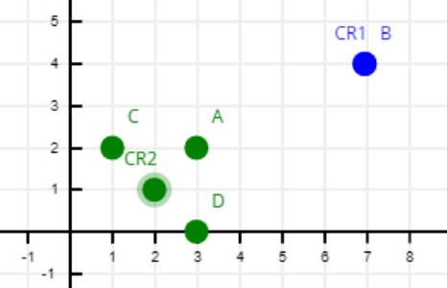

calculate the variance (Step 4) cr = ($\frac{\text{∑}xi}{n} ,\frac{\text{∑}yi}{n})$ $n$ = number of point in the CL cluster
CR1 = ($\frac{\text{7}}{1} ,\frac{\text{4}}{1})$ = (7,4)
CR2 = ($\frac{\text{1+3+3}}{3} ,\frac{\text{2+0+2}}{3})$ = ($\frac{\text{7}}{3}$, $\frac{\text{4}}{3}$)

Slide 16
WE repeat step 3 and 4. stop condition : when the point CL1 and CL2 stop changing.
So :
CL1 = { b}
CL2 = { C, D, a}

Slide 17
Optimal Value of K (Elbow Method)
The Elbow method is one of the most popular ways to find the optimal number of clusters. This method uses the concept of WCSS (Within Cluster Sum of Squares) value.
WCSS= ∑_{Pi in Cluster1} distance(P_{i} C₁)² +∑_{Pi in Cluster2}distance(P_{i} C₂)² with k=2
We executes the K-means clustering on a given dataset for different K values (ranges from 1-15).
For each value of K, we calculates the WCSS value.
Plots a curve between calculated WCSS values and the number of clusters K.

Slide 18
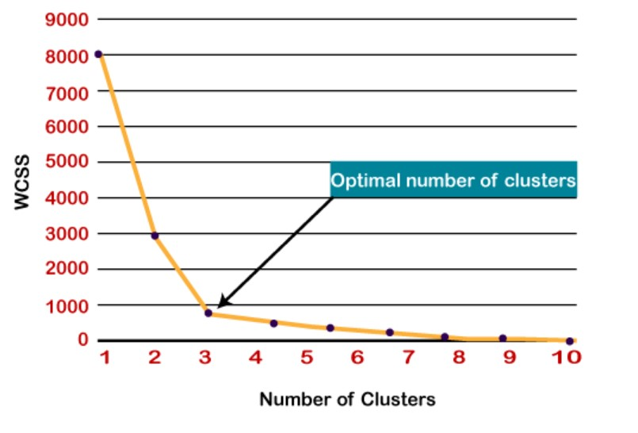
The optimal K is 3
Optimal Value of K (Elbow Method)

Slide 19
References
Dataset :
https://gist.github.com/pravalliyaram/5c05f43d2351249927b8a3f3cc3e5ecf
Examples :
https://www.javatpoint.com/k-means-clustering-algorithm-in-machine-learning

